Slide 1
Welcome
Notes:
Welcome and thank you
Hope of some relevance

Slide 2
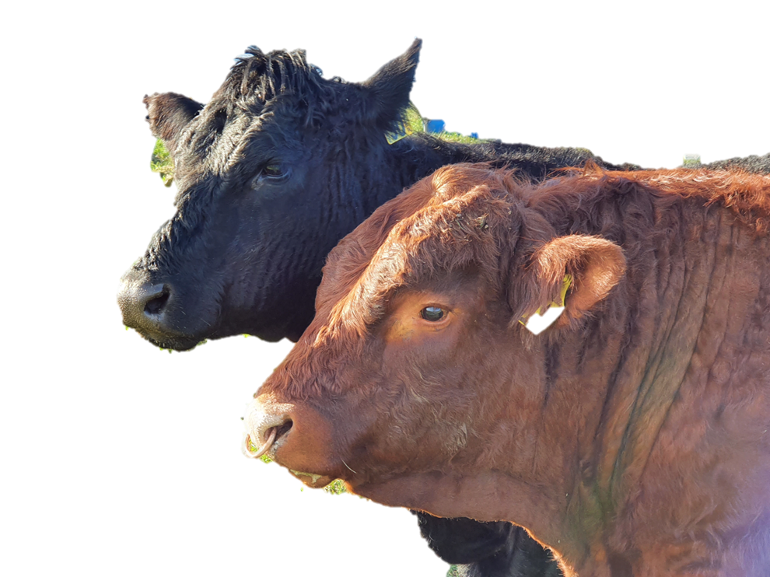
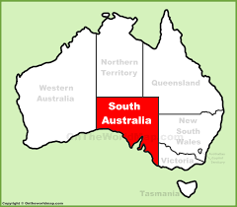
SA SALERS
Notes:
Welcome and thank you
Hope of some relevance

Slide 3
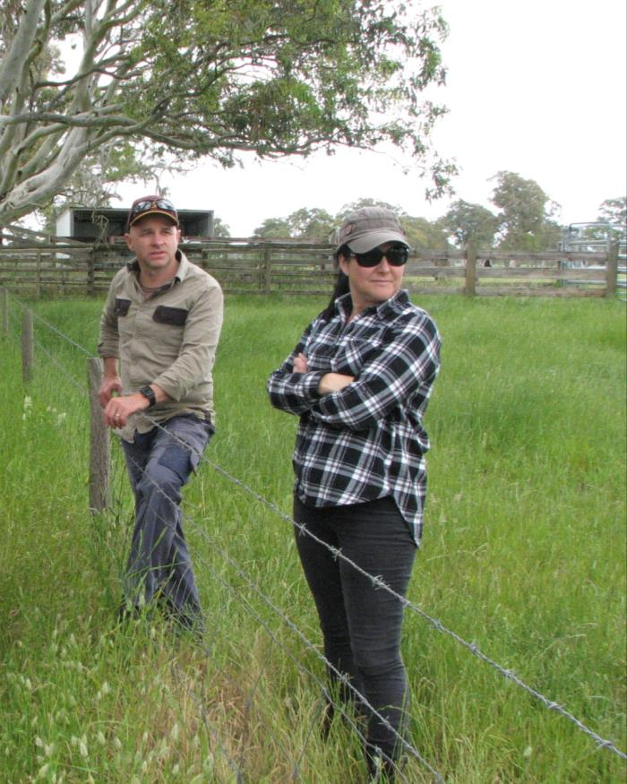
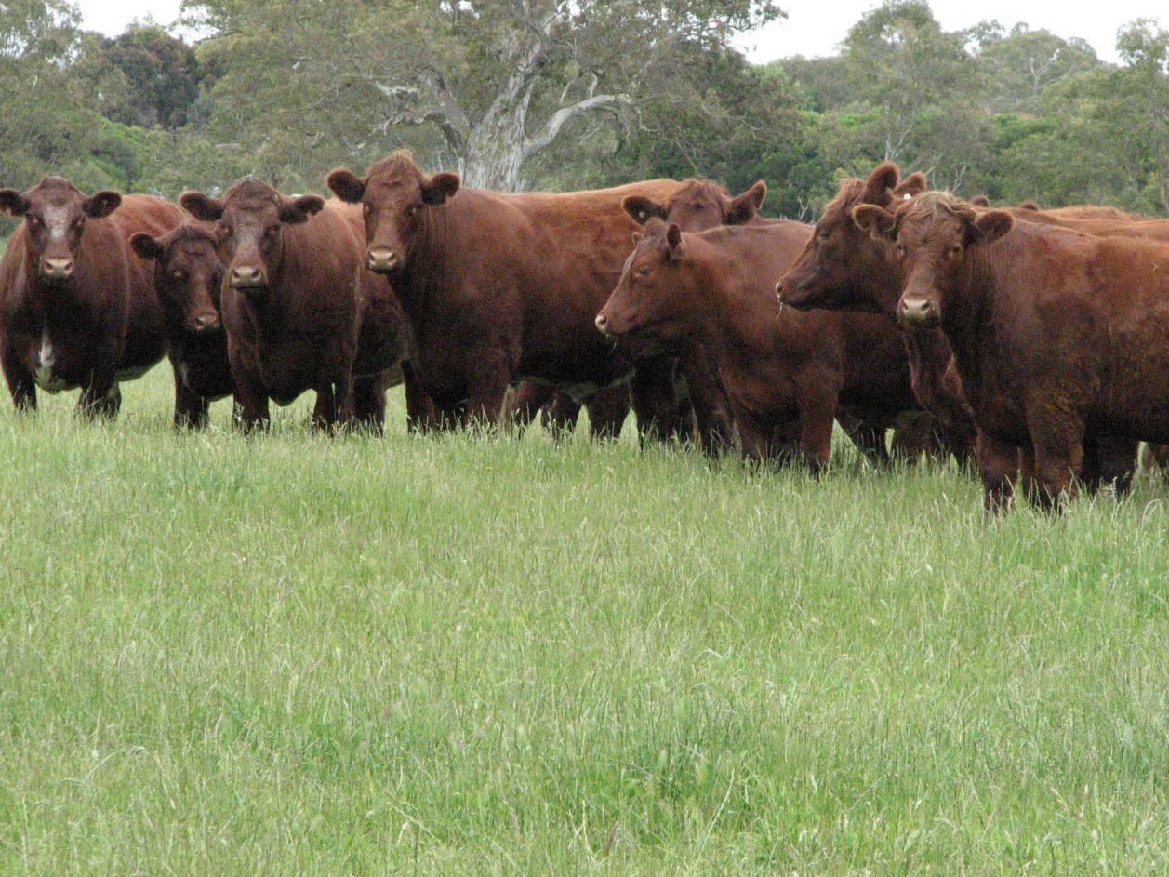
Bucks Hill Salers
Mark and Susie

Slide 4
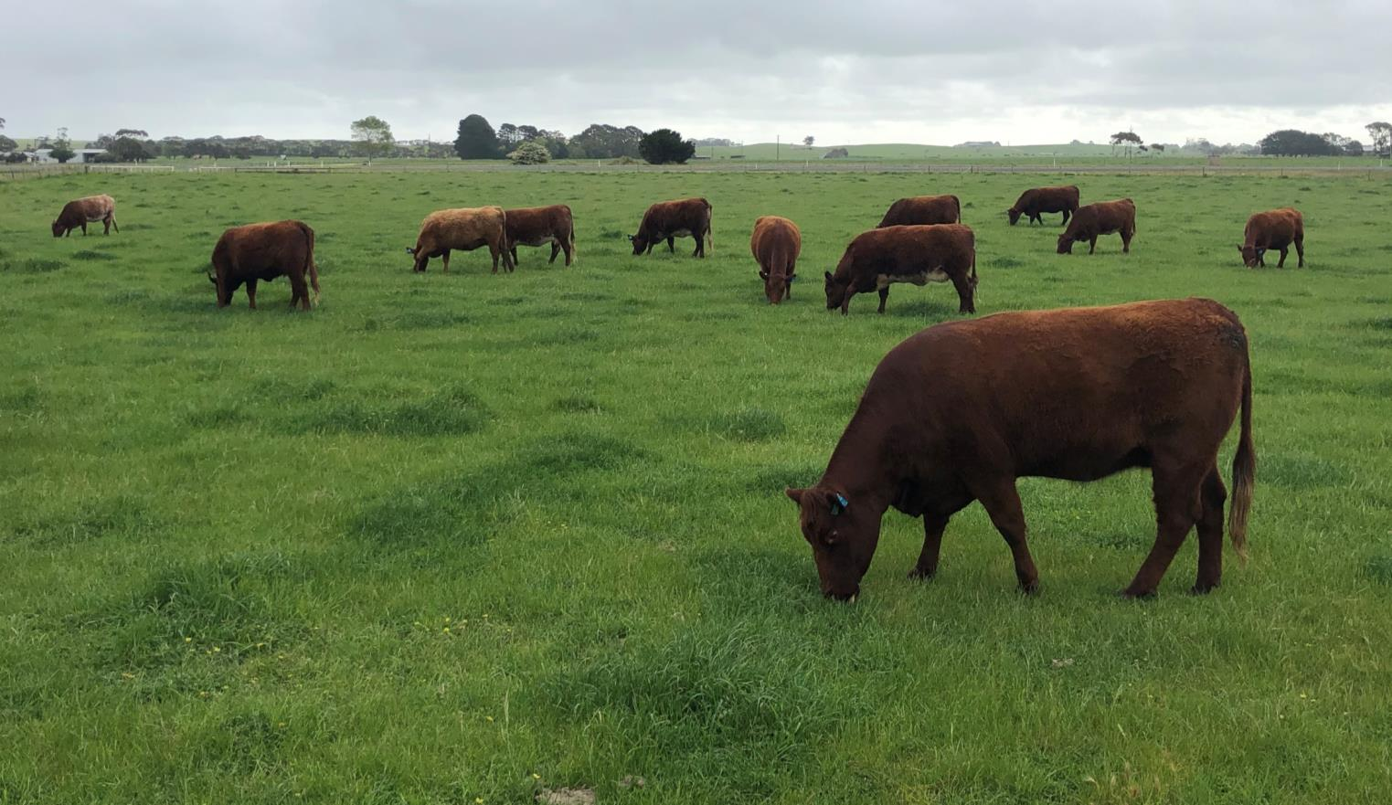
Some of our Salers x (Shorthorn) girls having a feed.

Slide 5
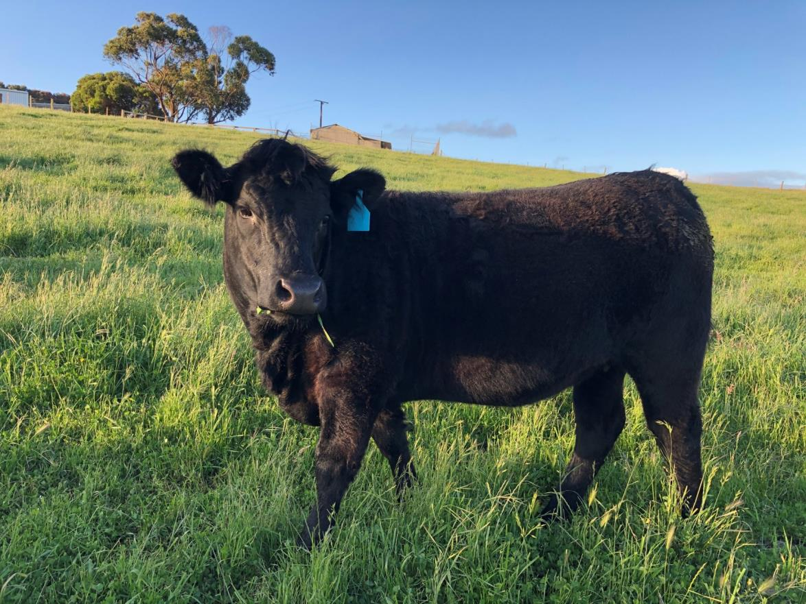
One of our own breeding, 20 month old heifer ready for joining.

Slide 6
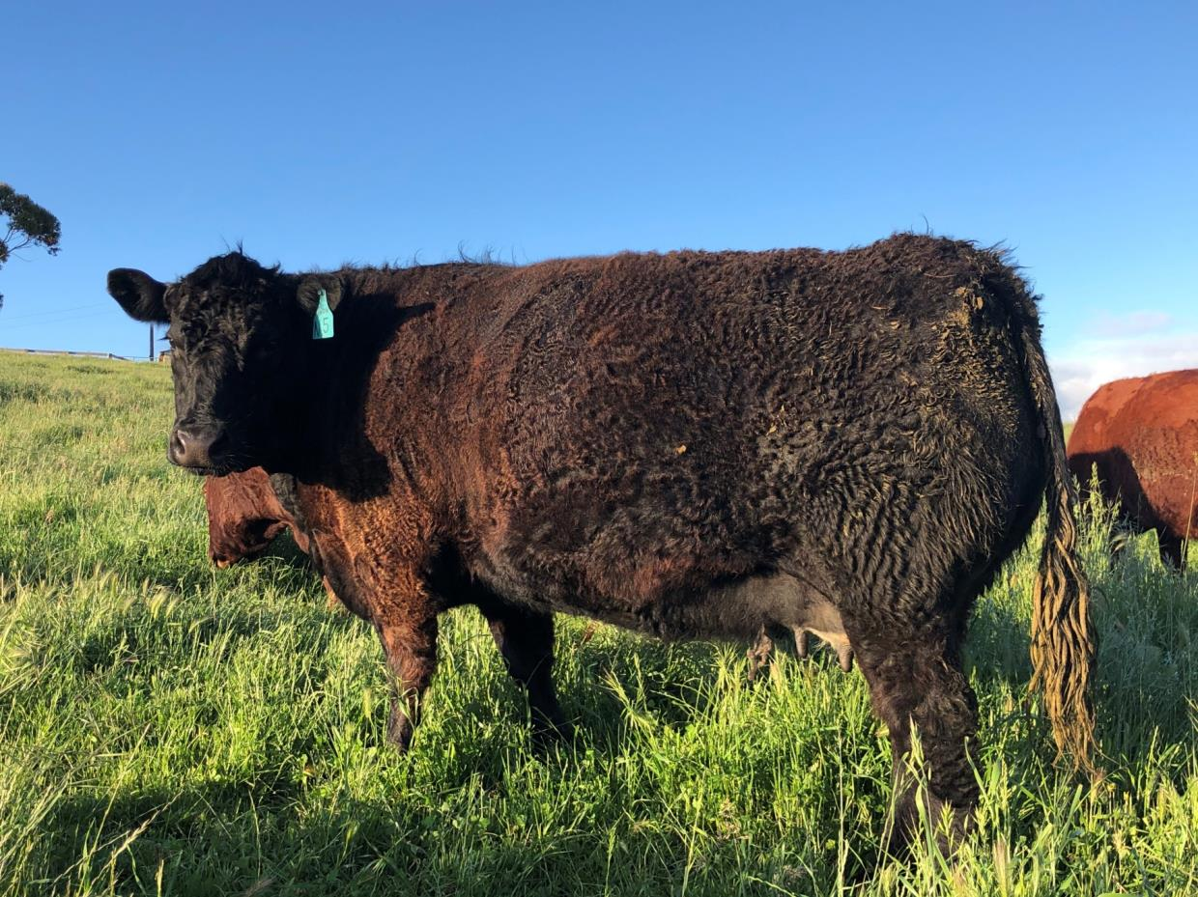
Someone has been in a good paddock.

Slide 7
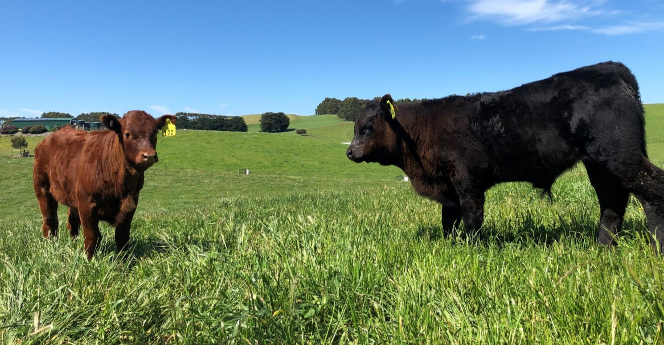
A couple of our 2-month-old Salers calves. The black, is one staying as a bull calf for now, he’s got a good look.

Slide 8
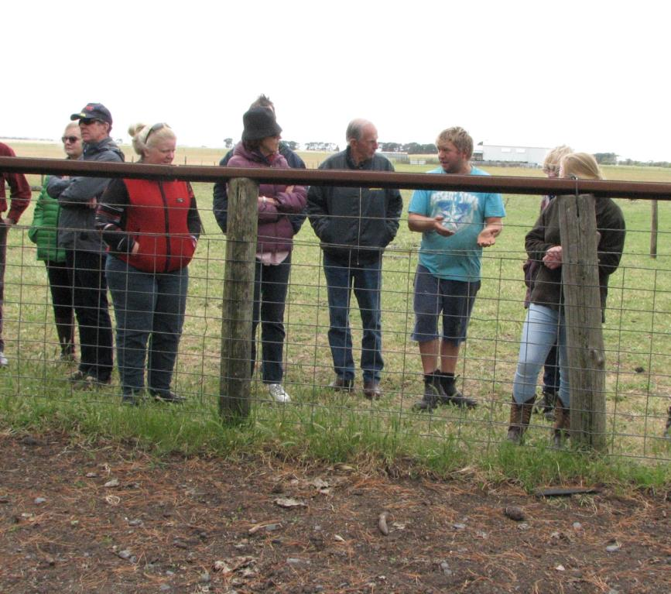
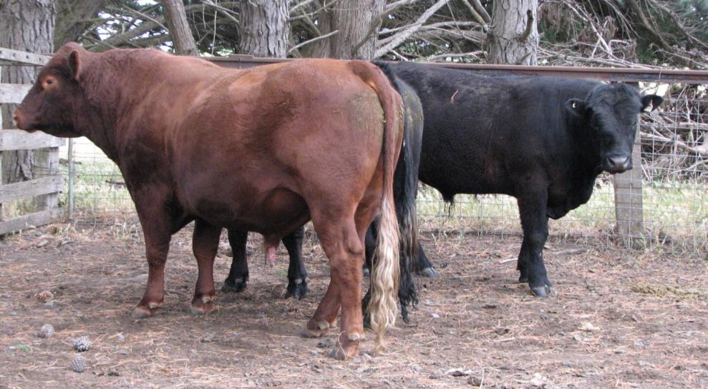
Weopa Pastoral Salers
Tim and
Megan

Slide 9
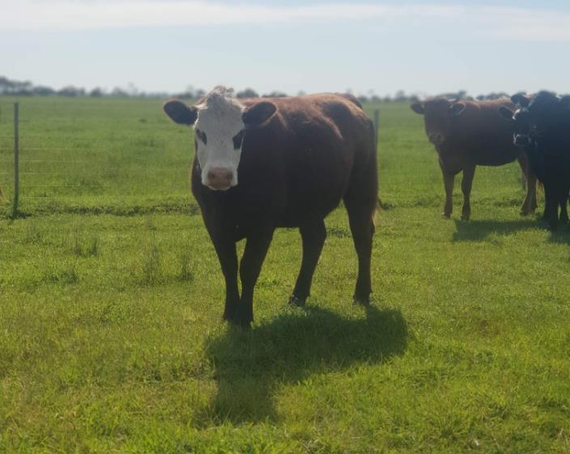
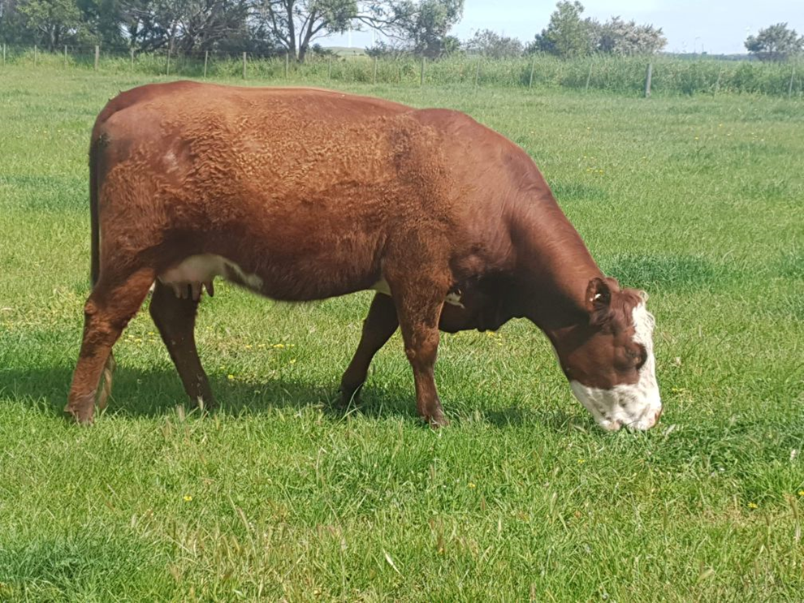
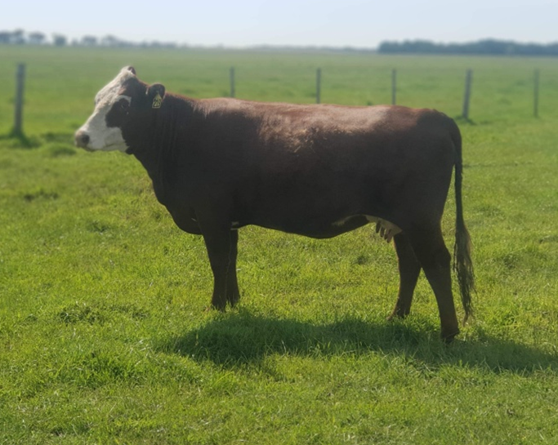
Salers x Hereford cows

Slide 10
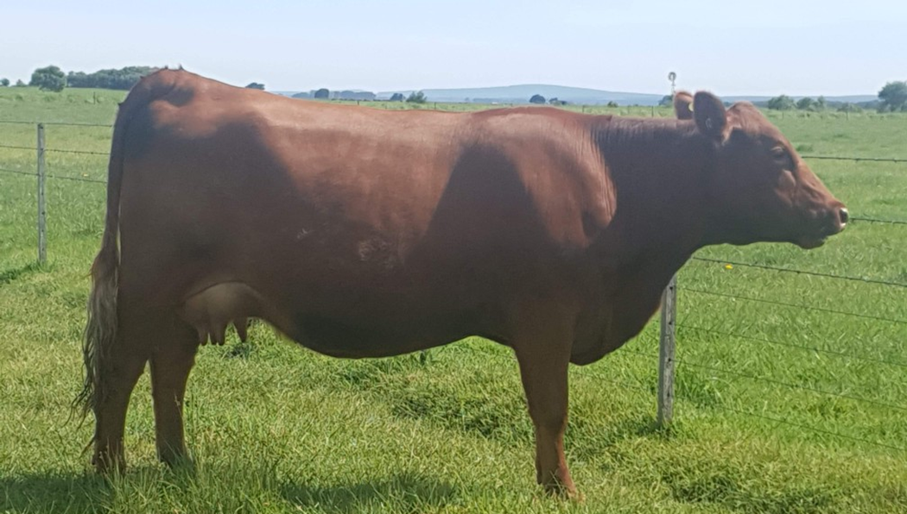
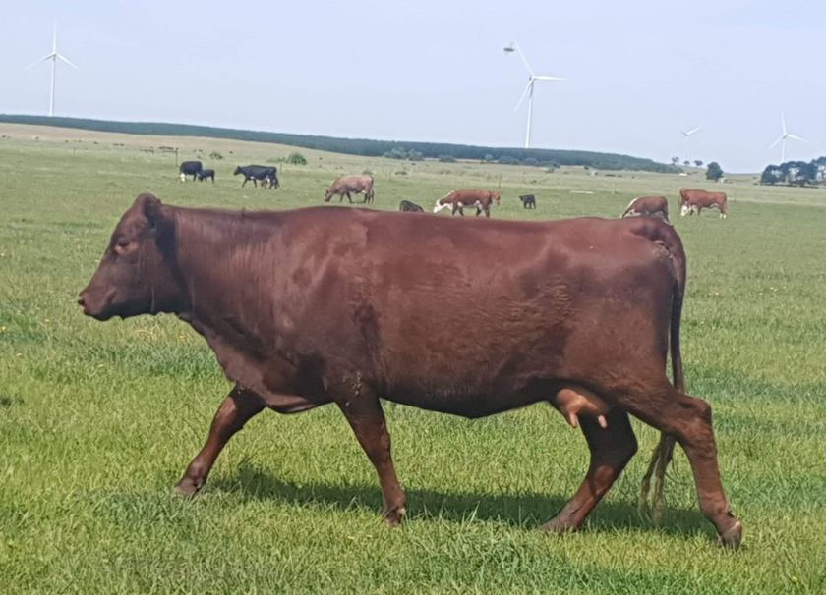
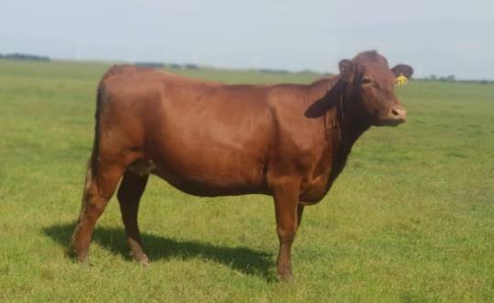
Salers x Shorthorn or Red Angus cows

Slide 11
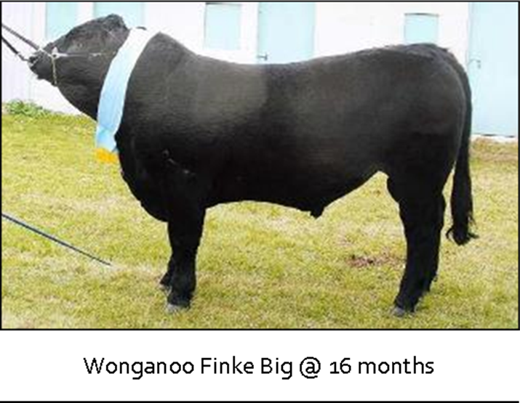
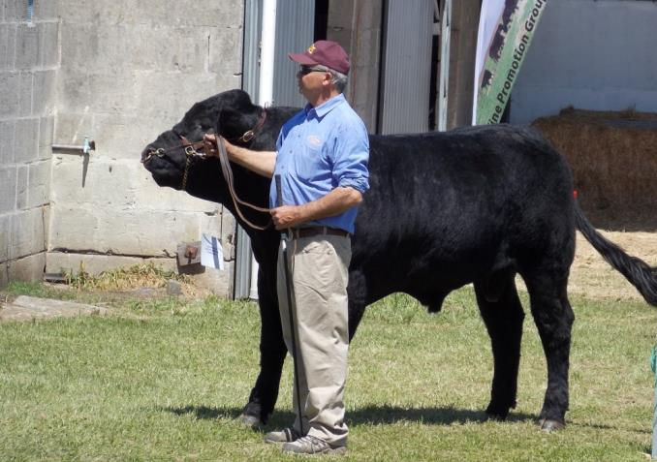
Wonganoo Salers
Steve, a very big thank you from all the SA Salers breeders for your support and guidance.

Slide 12
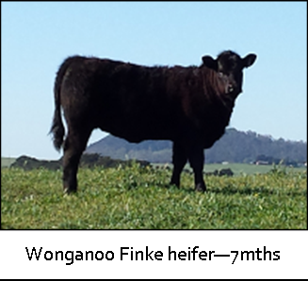
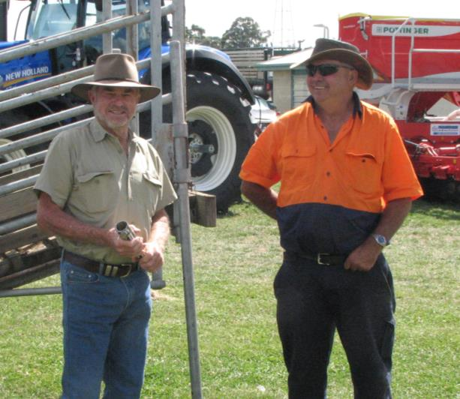
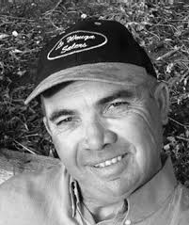
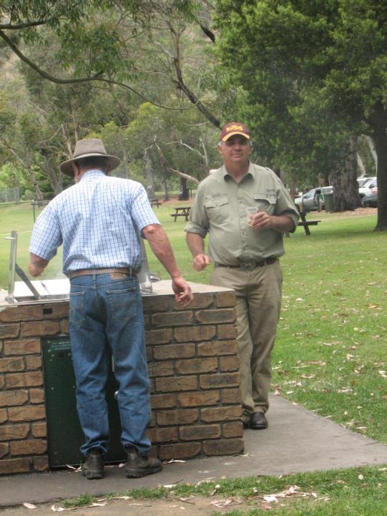
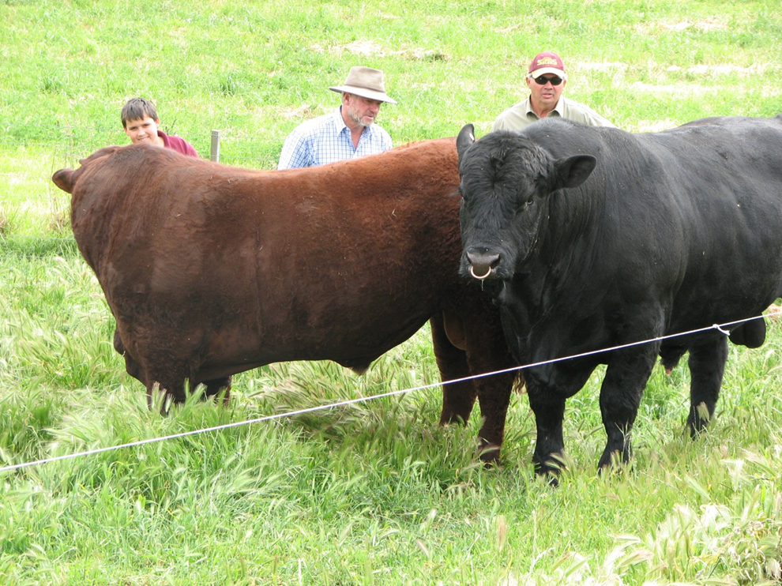

Slide 13
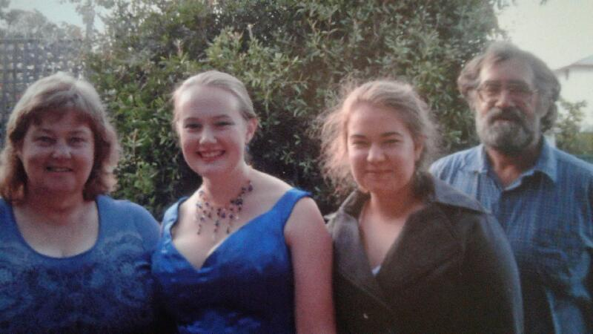
Kaninka Salers
Rosemary, Kelly, Laura and Hugh

Slide 14


This Salers herd has paid for Le Cord en Bleu patisserie training and a Uni Anthropology degree
The original females are of Wonganoo Salers blood lines.
They recently purchased a new bull with WA genes from Cara Park Salers

Slide 15
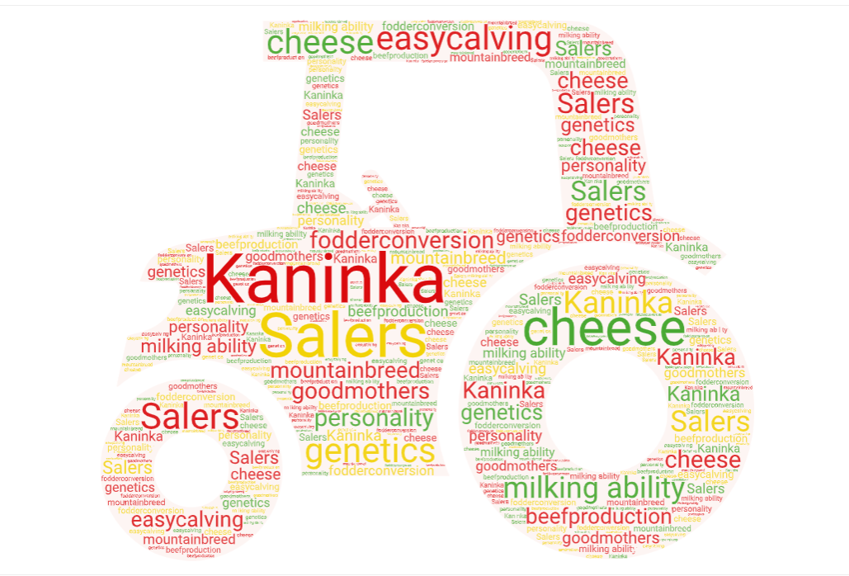
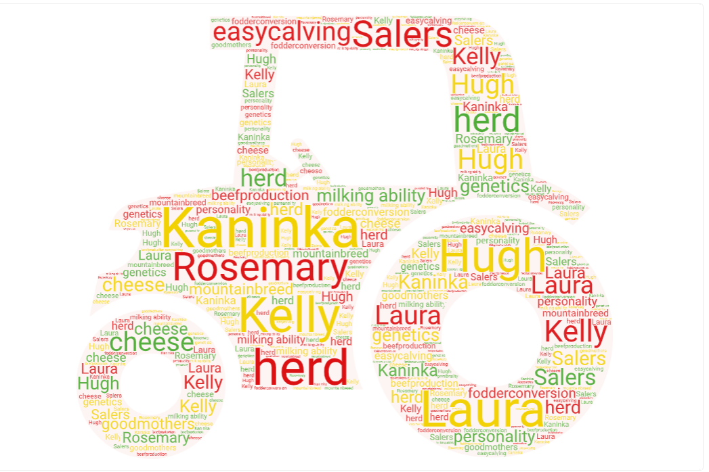
Why we choose Salers

Slide 16
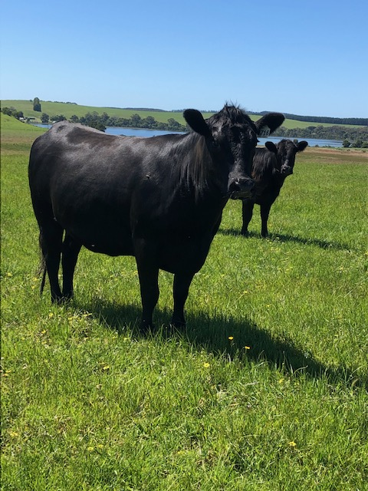
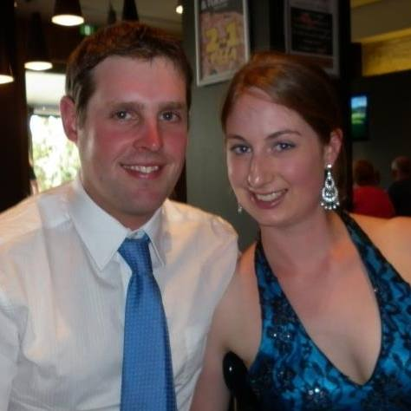
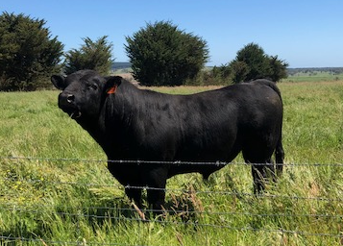
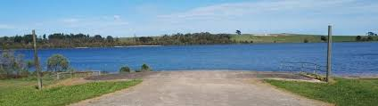
Lake Leak – Kooeeyong Salers
Jake and Kathryn

Slide 17
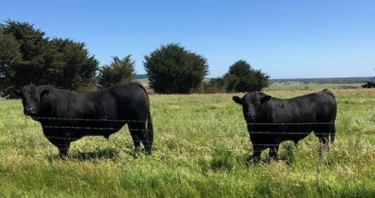
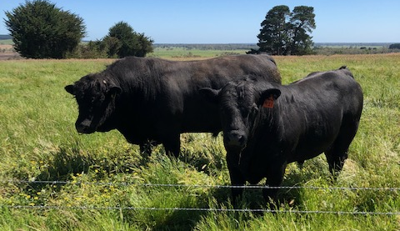
The Salers boys from Wonganoo & Cara Park

Slide 18
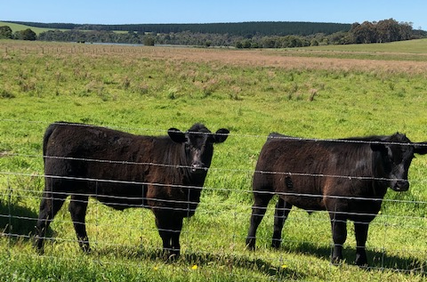
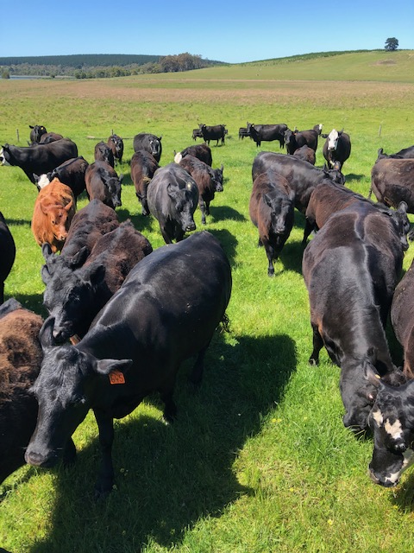
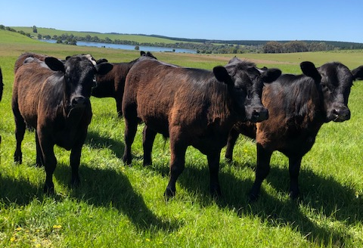
Young stock and a cow trail

Slide 19
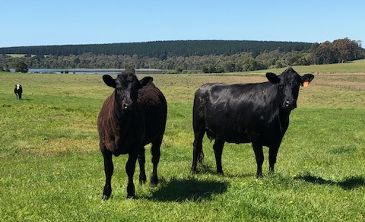
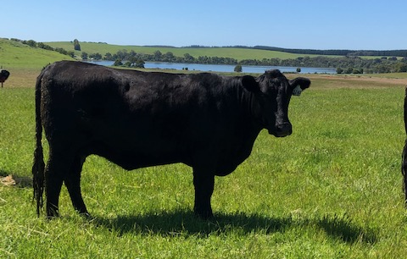
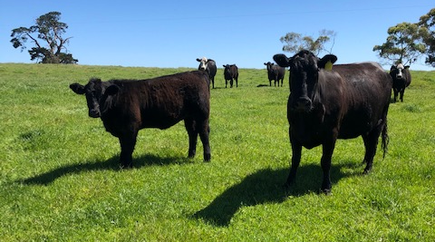
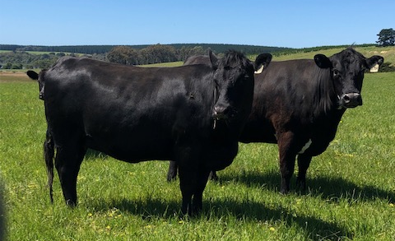
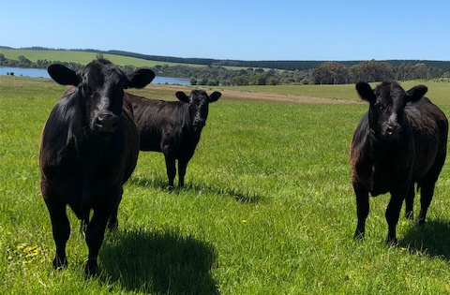
Salers x Angus cows

Slide 20
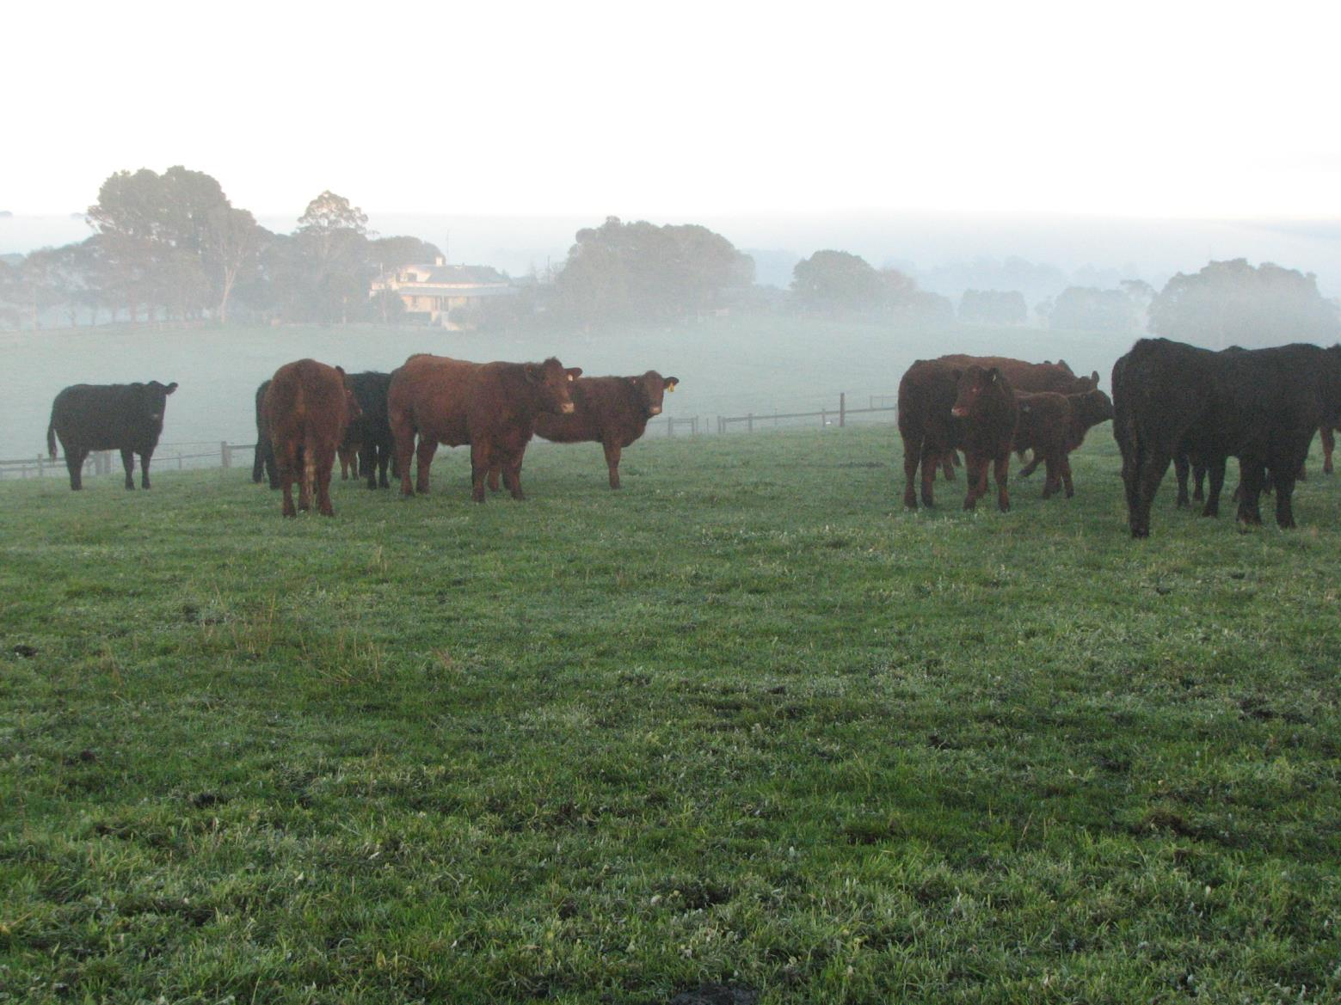
Cara Park Salers
Cara Park Salers
Roz and Ainsley
OB Flat SA
Notes:
Welcome and thank you
Hope of some relevance

Slide 21
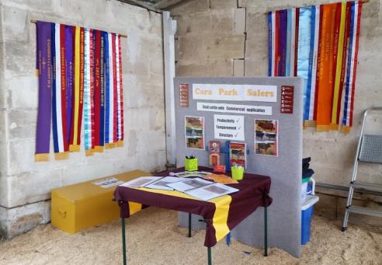
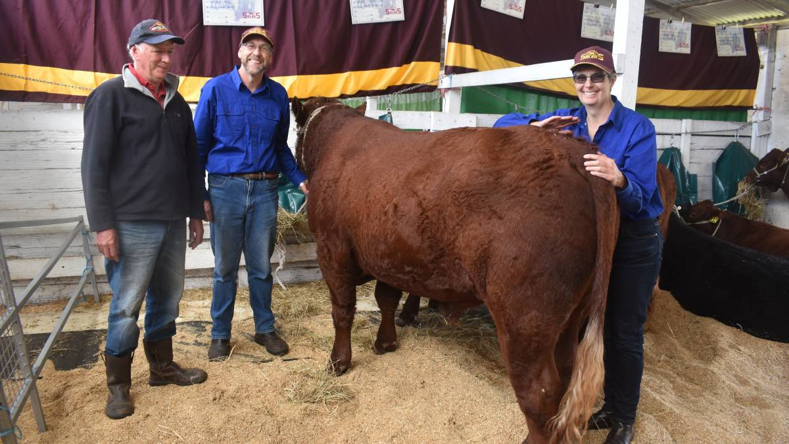
Beef Week display 2020

Slide 22
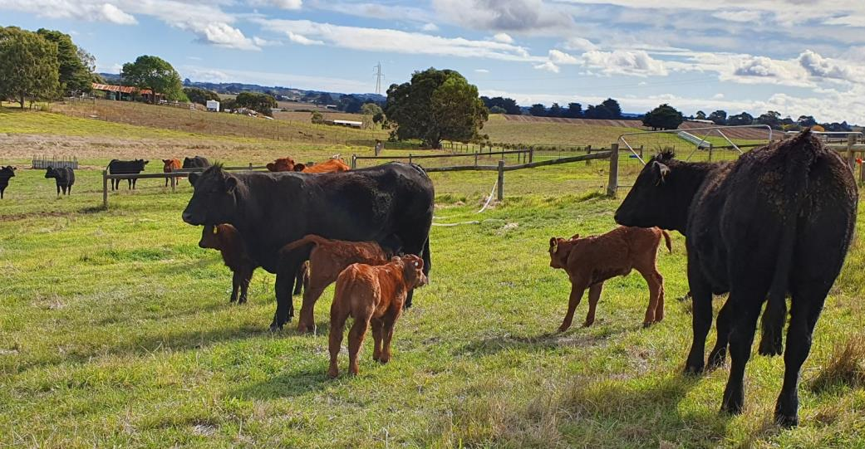
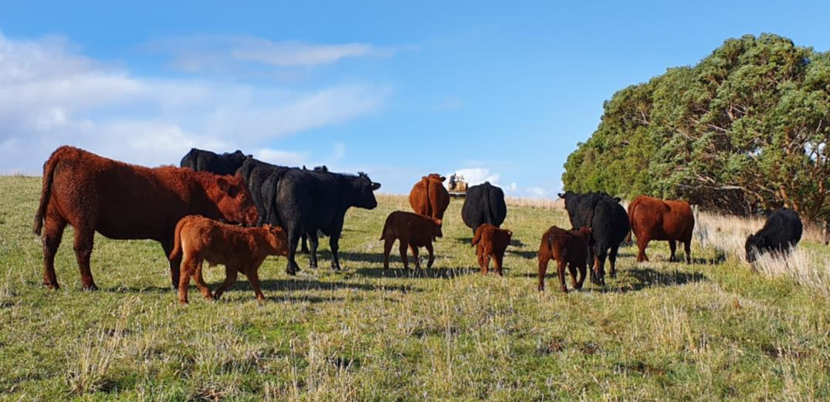
March calves

Slide 23
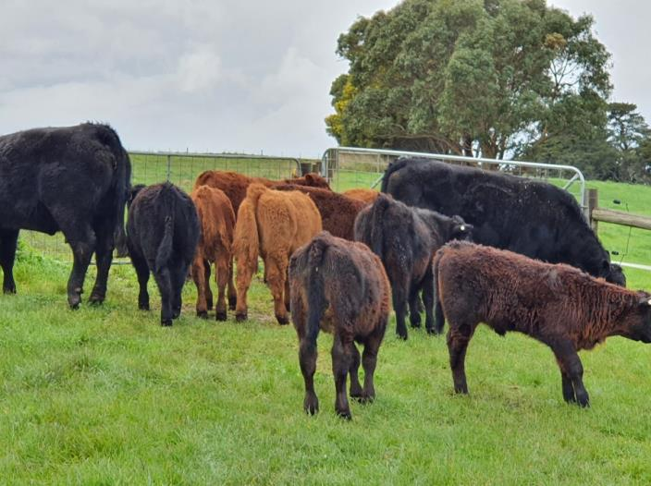
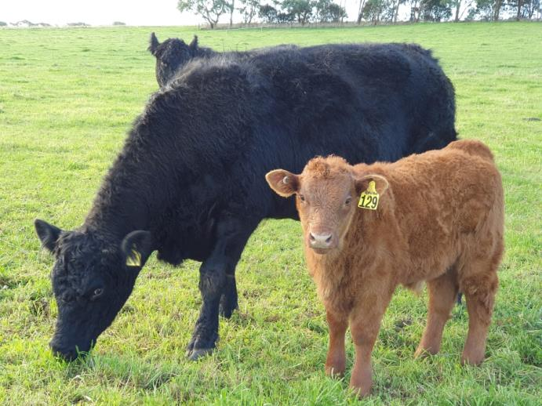
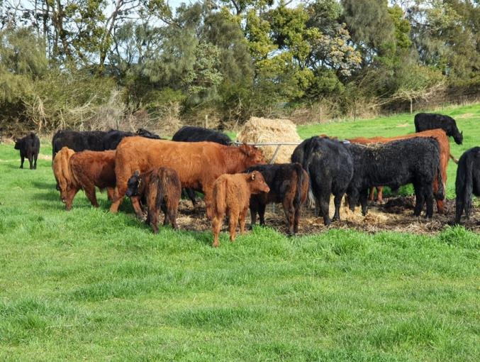
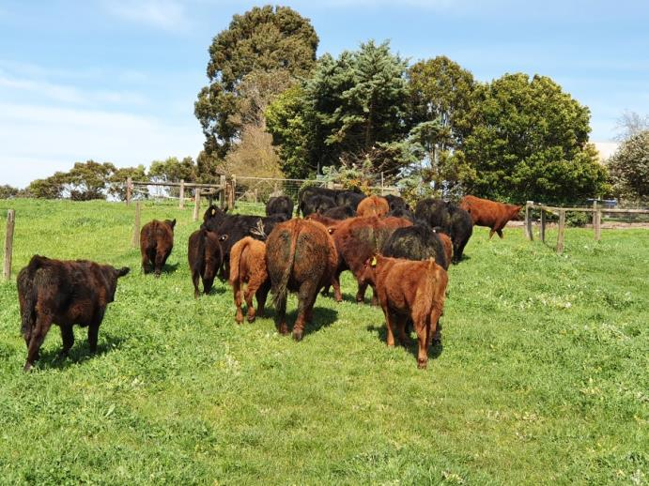
August/September

Slide 24
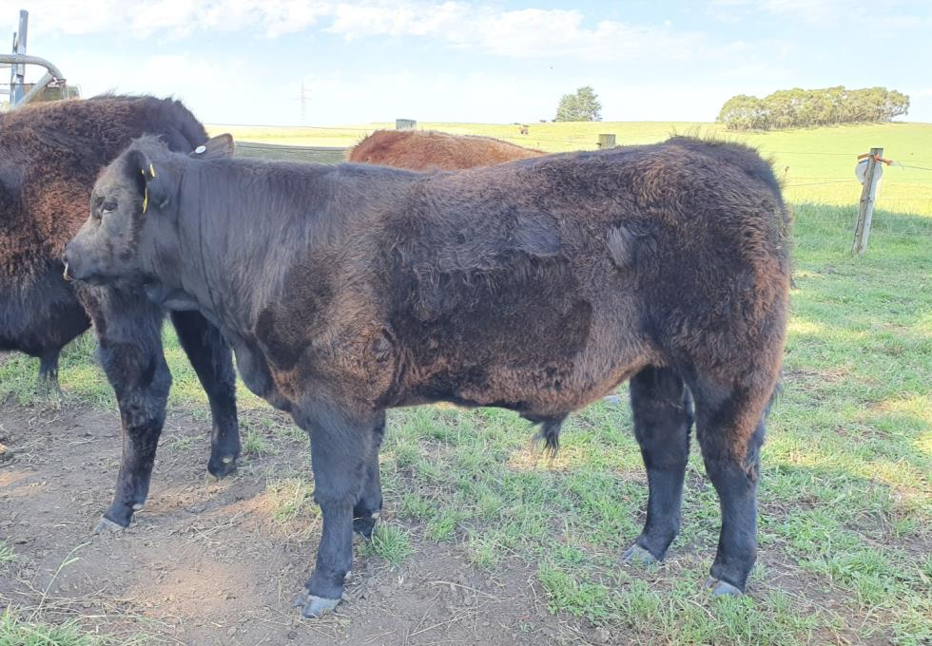

Rolled Roast

Slide 25



Ranim

Slide 26


Reginald

Slide 27





NO Shows, so we reminisce

Slide 28




Our virtual show team

Slide 29


Cara Park Q
AGE – 19 ½ months
Sire - CARA PARK NOT LATE CAR PN074 (P) CAR PN074
Dam - CARA PARK MOLLY CAR PM066 (P) (BL) CAR PM066
For Sale

Slide 30



Cara Park Quebec
AGE – 20 months
Sire - ALSHA BAYLEE JOHNSON ASB PJ041 (P) ASB PJ041
Dam - CARA PARK KATHRYN CAR PK043 (P) (BL) CAR PK043
For Sale

Slide 31

See Cara Park Salers at Beef Week 2021
Thursday January 28th
Mt Gambier Show grounds

Slide 32

Merry Christmas from SA.

